Slide 1

EMAIL SPAM DETECTION BASED ON TEXT CLASSIFICATION
TEAM MEMBERS
Sahithi Karingula

Slide 2
ABSTRACT
Today, internet users are increases Spam mail is the major problem and big challenges for researcher to reduce it. Spam is commonly defined as unsolicited email messages and the goal of spam categorization is to distinguish between spam and legitimate email messages. Many machine learning algorithm are used to classified the spam and legitimate mail. But we have identified the best classification approach using benchmark dataset. Clustering messages allows for efficient labeling of a representative sample of messages for learning a spam detection model using a Random Forest for classification and active learning for refining the classification model.

Slide 3
RESEARCH QUESTION
WHY DO PEOPLE SEND SPAM??
Spam is the electronic equivalent to junk email.
People send Spam in order to sell products and services or to promote an email scam.
The bulk of Spam is intended, however, to draw traffic to web sites or to sell other money-making schemes.
This can be shown by using special characters like '@' rather than the letter 'A' in words though the spam email.
Our aim is investigation of spam and hams using different machine learning techniques.

Slide 4
MOTIVATION
Email spam, also known as junk email, is a type of electronic spam where unsolicited messages are sent by email.
The proportion of spam email was around 54.68% of email messages sent, in the end of 2019.
It was estimated that in 2009 spam cost businesses around US$130 billion worldwide.
Many solutions available to tackle this problem, but one of the most efficient is email filtering based on the content of the email.

Slide 5
SPAM PROBLEMS
PROBLEMS RELATED TO COSTS
Spam imposes costs on all Internet users. These costs have been increasing with the growth of the number of spam messages infiltrating the Internet daily.
PROBLEMS RELATED TO PRIVACY
The collection of e-mail addresses is frequently made without the users’ knowledge, much less with a specification of the purpose and consent.
PROBLEMS RELATED TO SPAM CONTENT
The content of spam messages may create a problem due to fraud and deception.

Slide 6
WAYS TO IDENTIFY SOME SPAM EMAILS
The message is sent from a public email domain
The domain name is misspelled
The email is poorly written
It includes suspicious attachments or links
The message creates a sense of urgency

Slide 7
PREVIOUS APPROACHES
Calculating Term Frequency(TF)
Huge bag of words
Lack of Vector Space
Latent Semantic Analyzing(LSA)
Term-Text Matrix
Difficult to explain

Slide 8
DATA SET – SPAM COLLECTION
Available at UCI Machine Learning Repository
Number of instances – 5634 ; no missing values
Number of columns – 2 (label & message)
Classification levels – 2 i.e. spam and not spam

Slide 9
DATASET FOR THE MODEL AND TESTING
NLTK(Natural Language Toolkit) library is imported.
Raw data(5547 observations & 2 columns) is spitted into train and test set in 80:20 proportion
Proportion of classes : ~13% spam and ~87% not spam
Train data is passed through NLP pipeline to create vectorised features for the model to train.
Same train pipeline is used to create test vectorised data frame
Now we have two vectorised data frames (train and test) of the same width i.e. 7085 columns

Slide 10
APPROACH
RANDOM FOREST ALGORITHM
Random Forest algorithm is a supervised classification algorithm. We can see it from its name, which is to create a forest by some way and make it random.
There is a direct relationship between the number of trees in the forest and the results it can get: the larger the number of trees, the more accurate the result.
But one thing to note is that creating the forest is not the same as constructing the decision with information gain index approach.
Random Forest, the process es of finding the root node and splitting the feature nodes will run randomly.
There are two stages in Random Forest algorithm, one is random forest creation, the other is to make a prediction from the random forest classifier created in the first stage

Slide 11
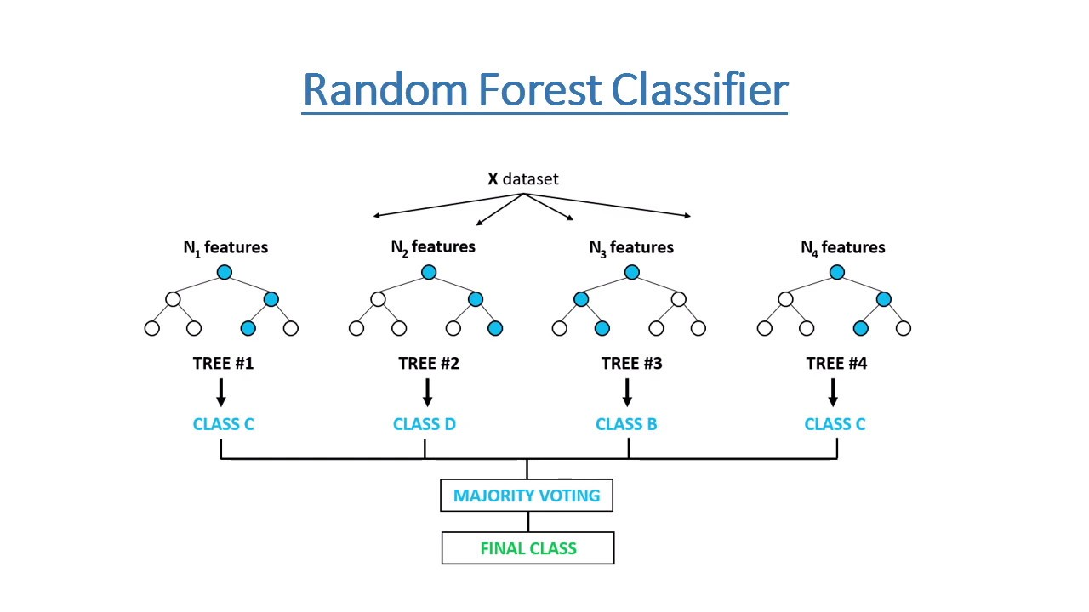
FLOW OF THE ALGORITHM

Slide 12
IMPLEMENTATION
Created two new features:
Length of message
Punctuation Percentage in the message
Now our data set has 4 columns (label, message, message_length, Punct %)
Feature Creation
Remove punctuations
Tokenization
Remove stop words
Data Cleaning
Vectorization
Term Frequency – Inverse Document Frequency (IDF)
Count Vectorization
Vectorization

Slide 13
NLP FLOW
Tokenizing
Removing
Stop words
Stemming/
Lemmatizing
NLP Modelling
Vectorization

Slide 14
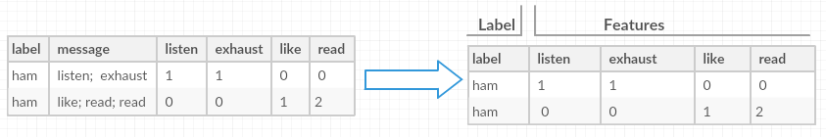
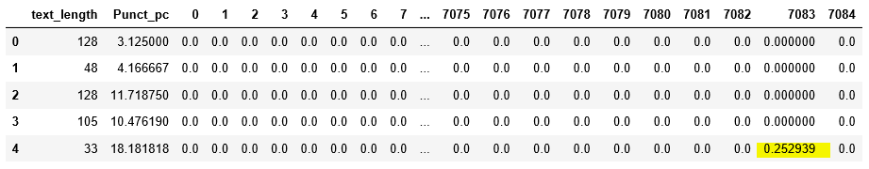
DATASET FOR THE MODEL
CONCEPTUALLY
TRAIN DATASET

Slide 15
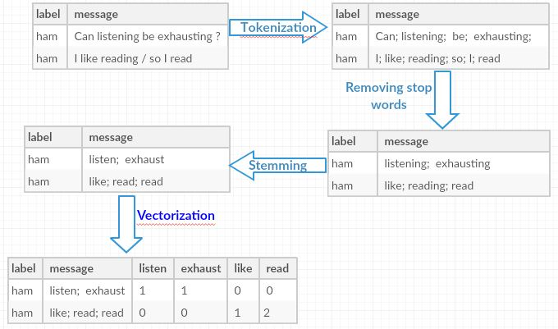

Slide 16
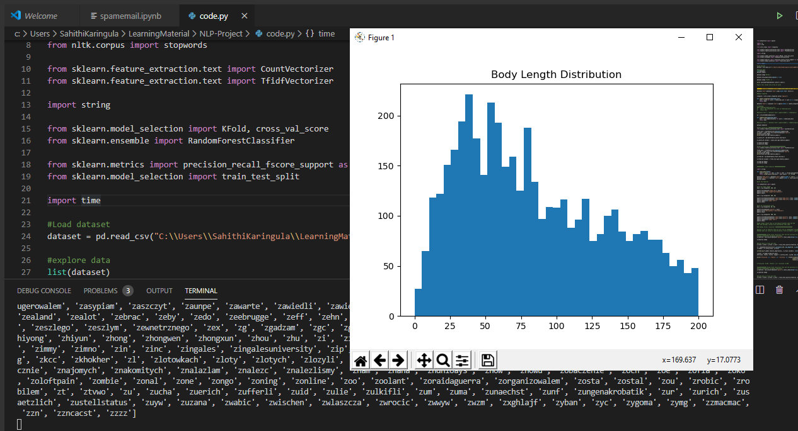
EXPERIMENTAL SETUP

Slide 17
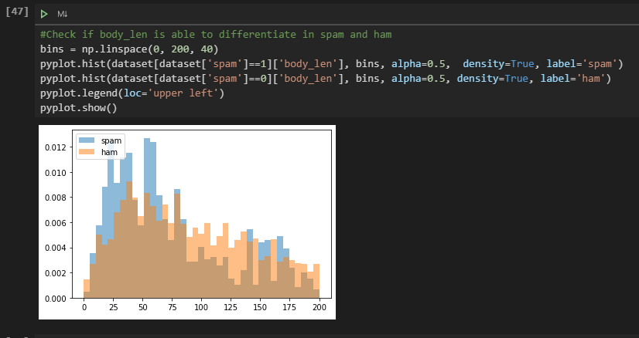
DIFFERENTIATE BETWEEN SPAM AND HAM

Slide 18
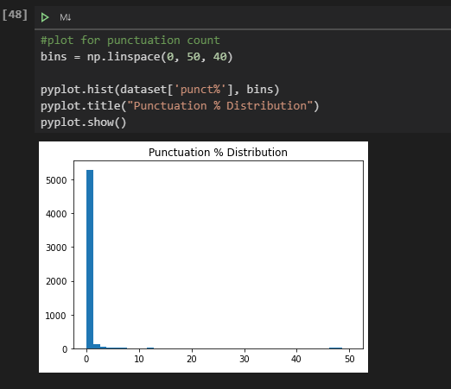
ERROR ANALYSIS
Initially we have considered only the words from the corpus but later we have also considered the punctuation which helped to achieve more accurate results.

Slide 19
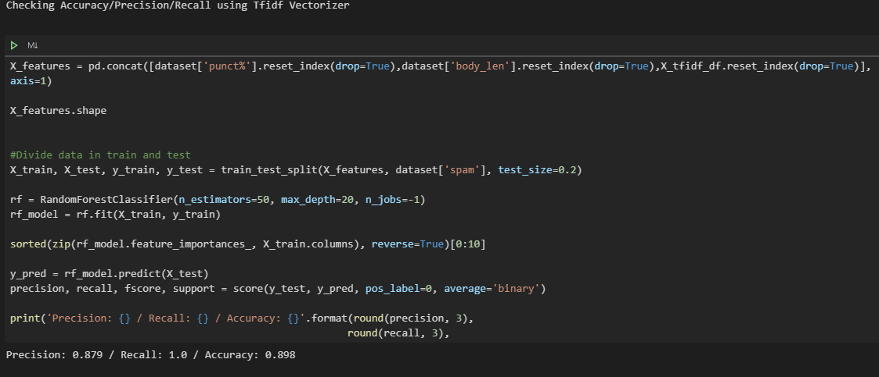
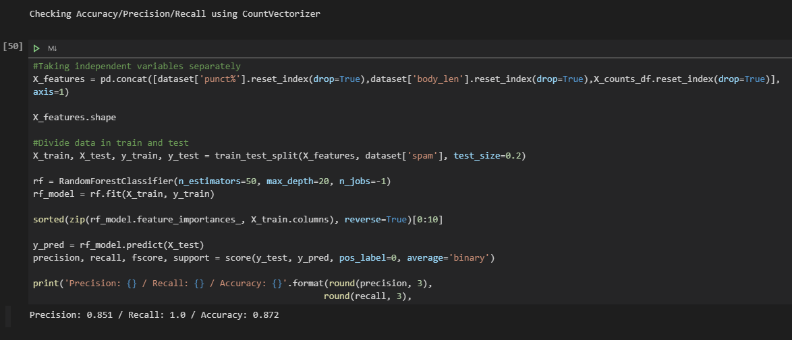
RESULTS

Slide 20
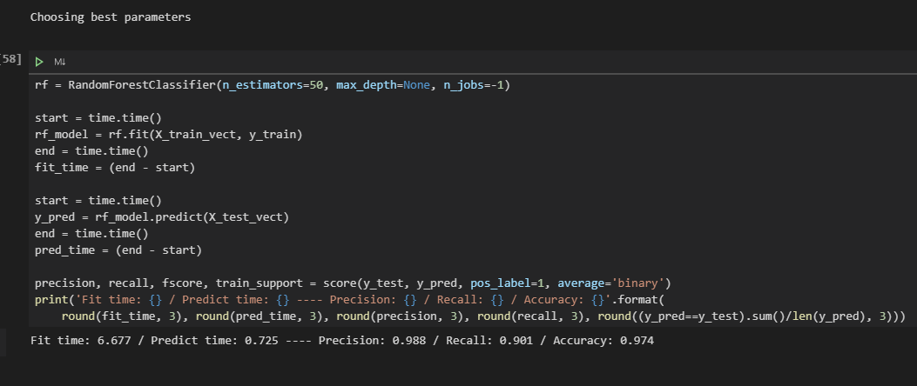

Slide 21
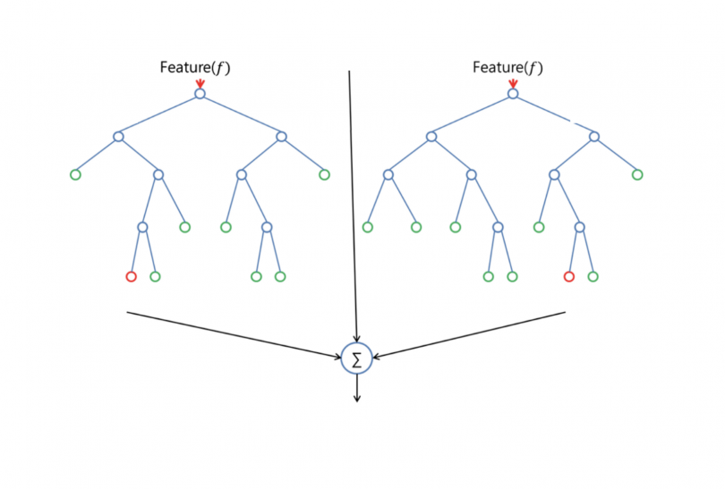
FUTURE WORK
Longer Training Period: Random Forest require much more time to train as compared to decision trees as it generates a lot of trees (instead of one tree in case of decision tree) and makes decision on most votes.

Slide 22
REFERENCES
http://scikit-learn.org/
http://xgboost.readthedocs.io/en/latest/build.html#python-package-installation
https://en.wikipedia.org/wiki/Email_spam
https://images.google.com
https://www.nltk.org/py-modindex.html

Slide 23
THANK YOU

